Slide 1
Software Engineering Requirements Analysis
CS 1530
Summer 2020
Instructor: Sohel Sarwar
University of Pittsburgh
Lecture 4 Requirements

Slide 2

What is Specification?:
The invention and definition of the behavior of a new system (solution domain) such that it will produce the required effects in the problem domain
Starts from a knowledge of the problem domain and the required effects are determined by elicitation and analysis
Generally involves modeling
Results in the specification document. Precise expression of requirements, may include models.
Requirements
Analysis
Software Specifications
Specification
description of Solution System needed to satisfy Problem Domain
Domain properties
Requirements
Hardware
Software

Slide 3
Types of Requirements:
Functional requirements: The mandatory features and functionalities of the software, which are directly experienced by the end users, are referred to as Functional requirements. These are expressed in user stories and involve most of the work in building solutions that deliver value to the user. Types of functional requirements:
input/output
processing.
error handling.
Non-functional requirements: System attributes, restrictions, constraints, performance, quality, etc., which are indirectly related to system behavior as experienced by the end users, are referred to as non-functional requirements. Types of non-functional requirements are:
Physical environment (equipment locations, multiple sites, etc.).
Interfaces (data medium etc.).
Requirements
Analysis
Software Requirements

Slide 4
Requirements
Analysis
Software Requirements
Types of Requirements:
Non-functional requirements (Continued):
User & human factors (who are the users, their skill level etc.).
Performance (how well is system functioning).
Documentation.
Data (qualitative stuff).
Resources (finding, physical space).
Security (backup, firewall).
Quality assurance (max. down time, MTBF, etc.).

Slide 5
Requirements Analysis
The process of establishing what services are required and the constraints on the system’s operation and development.
Requirements engineering/analysis process involves
Feasibility study
Is it technically and financially feasible to build the system?
Requirements elicitation and analysis
What do the system stakeholders require or expect from the system?
Requirements specification
Defining the requirements in detail
Requirements validation
Checking the validity of the requirements
Requirements
Analysis
Software Requirements Specifications (SRS)

Slide 6
Requirements
Analysis
Software Requirements Specifications (SRS)
Requirements Analysis Objectives:
Identify customer’s needs.
Evaluate system for feasibility.
Perform economic and technical analysis.
Establish schedule and constraints.
Negotiate priorities of stakeholders.
Prioritize and triage requirements.
Create system definitions.

Slide 7
Requirements Analysis Objectives:
Elaborate system requirements, defined in the requirement specification document, such that managers can give realistic project estimates and developers can design, implement, and test.
Allocate functions to system elements.
Classify requirements information into various categories and allocate requirements to sub-systems.
Evaluate requirements for desirable qualities
Discover the boundaries of the new system (or software) and how it must interact with its environment within the new problem domain.
Detect and resolve conflicts between (user) requirements.
Requirements
Analysis
Software Requirements Specifications (SRS)

Slide 8
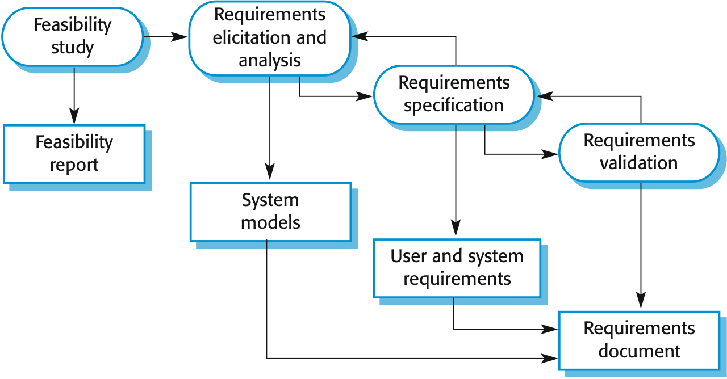
Requirements
Analysis
Software Requirements Specifications (SRS)
Requirements Analysis Workflow:

Slide 9
Requirements
Analysis
Software Requirements Specifications (SRS)
Stages of Requirements Engineering:
Inception
Elicitation
Elaboration
Negotiation
Specification
Validation
Management

Slide 10
Requirements
Analysis
Software Requirements Specifications (SRS)
Stages of Requirements Engineering: Inception
Ask a set of questions that establish …
basic understanding of the problem
the people who want a solution
the nature of the solution that is desired
the effectiveness of preliminary communication and collaboration between the customer and the developer

Slide 11
Requirements
Analysis
Software Requirements Specifications (SRS)
Stages of Requirements Engineering: Elicitation
Elicit requirements from all stakeholders
address problems of scope
address problems of understanding
customers are not sure about what is needed, skip “obvious” issues, have difficulty communicating with the software engineer, have poor grasp of problem domain
address problems of volatility (changing requirements)

Slide 12
Requirements
Analysis
Software Requirements Specifications (SRS)
Stages of Requirements Engineering: Elaboration & Negotiation
Elaboration: create an analysis model that identifies data, function, features, constraints and behavioral requirements
Negotiation: agree on a deliverable system that is realistic for developers and customers
rank requirements by priority (conflicts arise here …)
identify and analyze risks assoc. with each requirement
“guestimate” efforts needed to implement each requirement
eliminate, combine and / or modify requirements to make project realistic

Slide 13
Requirements
Analysis
Software Requirements Specifications (SRS)
Stages of Requirements Engineering: Specification
Can be any (or more) of the following:
A written document
A set of models
A formal mathematical model
A collection of user scenarios (use-cases)
A prototype

Slide 14
Requirements
Analysis
Software Requirements Specifications (SRS)
Stages of Requirements Engineering: Validation
A review mechanism that looks for:
errors in content or interpretation
areas where clarification may be required
missing information
inconsistencies (a major problem when large products or systems are engineered)
conflicting or unrealistic (unachievable) requirements
tests for requirements

Slide 15
Requirements
Analysis
Software Requirements Specifications (SRS)
Stages of Requirements Engineering: Management
Involves managing changes:
Feature traceability: how requirements relate to observable system/product features
Source traceability: identifies source of each requirement
Dependency traceability: how requirements are related to each other
Subsystem traceability: categorizes requirements by the sub system (s) they govern
Interface traceability: how requirements relate to both external and internal system interfaces

Slide 16
Requirements
Analysis
Software Requirements Specifications (SRS)
Requirements Engineering
Methods & Tools
Many of them available
lists
elicitation question list
checklists for validation
graphical diagrams, good for communication
formal methods
e.g. UML for elaboration and specification

Slide 17
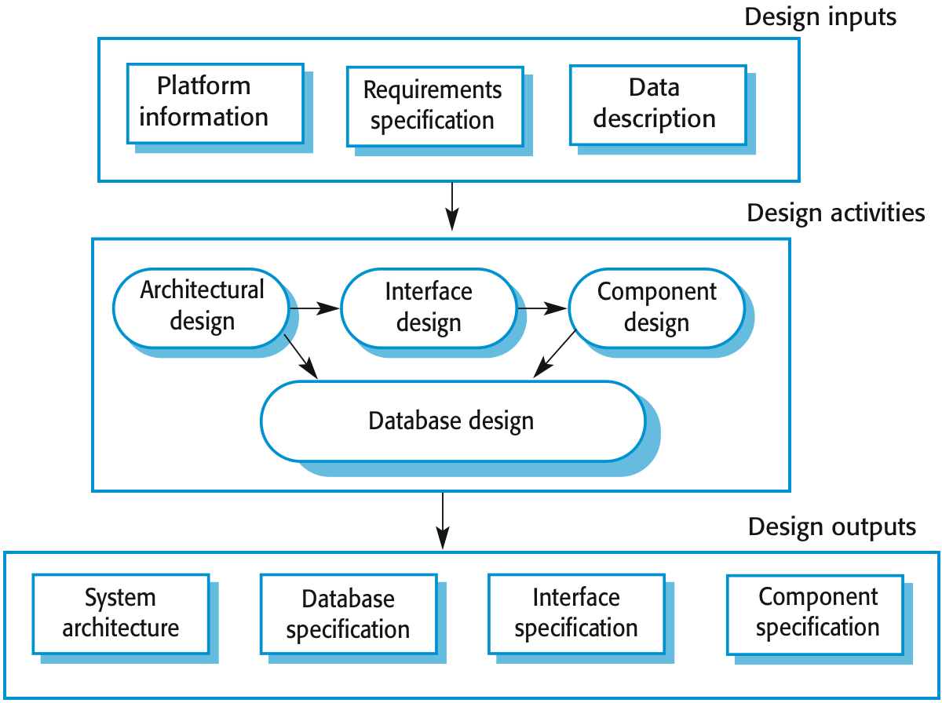

Software Design

Slide 18
Software Design
Architectural design, where you identify the overall structure of the system, the principal components (sometimes called sub-systems or modules), their relationships and how they are distributed using modelling techniques.
Interface design, where you define the interfaces between system components.
Component design, where you take each system component and design how it will operate.
Database design, where you design the system data structures and how these are to be represented in a database.

Slide 19
Software Design
Modeling:
Data model
shows relationships among system objects
Functional model
description of the functions that enable the transformations of system objects
Behavioral model
manner in which software responds to events from the outside world

Slide 20
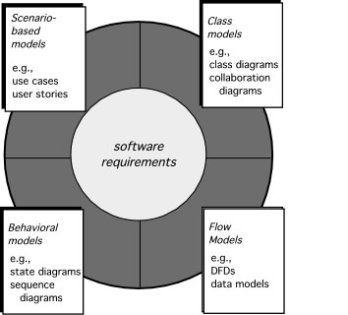
Software Design

